Slide 1


HUM 102 Report Writing Skills
Lecture 20

Slide 2

Previous Lecture
Basics, Purposes and Advantages of Letter Writing
Formal vs. Informal Letters
Inquiry Letter

Slide 3



Letter Writing
Complaint Letter
Also known as Claim Letters
Letter written to bring mistakes into notice
Usually written by a buyer to a seller highlighting all the problems faced at the time of receiving the order and its payment for resolution
Written after phones and emails
Formalizing a situation by bringing it in written form
Highlights customer’s dissatisfaction with the provided service/product

Slide 4
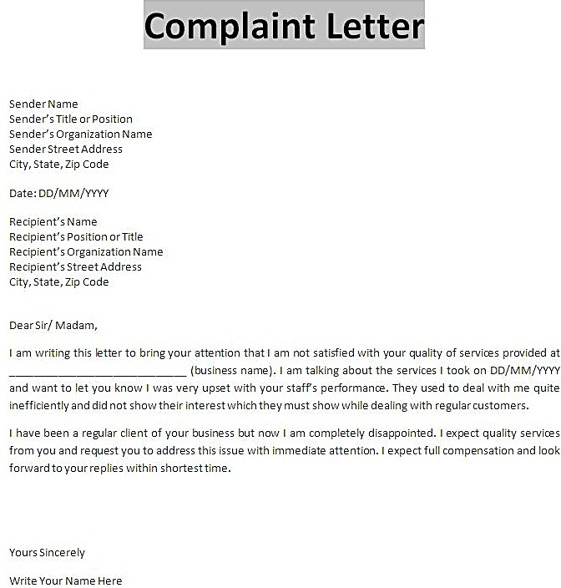

Source: http://bizcommunicationcoach.com/wp-content/uploads/2016/03/What-is-complaint-letter-1.jpg

Slide 5
Letter Writing
Complaint Letter: Introduction
In the introduction, politely state the problem. Although you might be angry over the service you’ve received, you want to suppress that anger.
Angry comments don’t lead to communication; they lead to combat. Because the angry reader won’t go out of their way to help you, your best approach is diplomacy.
To strengthen your assertions, in the introduction, include supporting documents such as the following:
Serial numbers, dates of purchases, invoice numbers, cheque numbers, names of sales people involved in the purchase
Also state that copies of these documents are enclosed

Slide 6
Letter Writing
Complaint Letter: Discussion
In the discussion paragraph, explain in detail the problems experienced.
This could include dates, contact names, information about shipping, breakage information, or itemized listing of defects.
In a complaint letter , every thing should be explained with proof.
Help your audience understand the extent of the problem.

Slide 7
Letter Writing
Complaint Letter: Conclusion
End your letter positively.
Remember, you want to ensure cooperation with the vendor and you want to be courteous, reflecting your company’s professionalism.

Slide 8
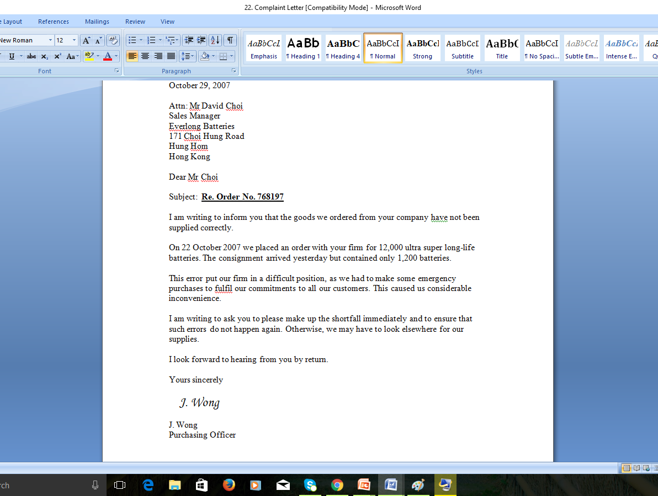
Sample:
Complaint
Letter

Slide 9
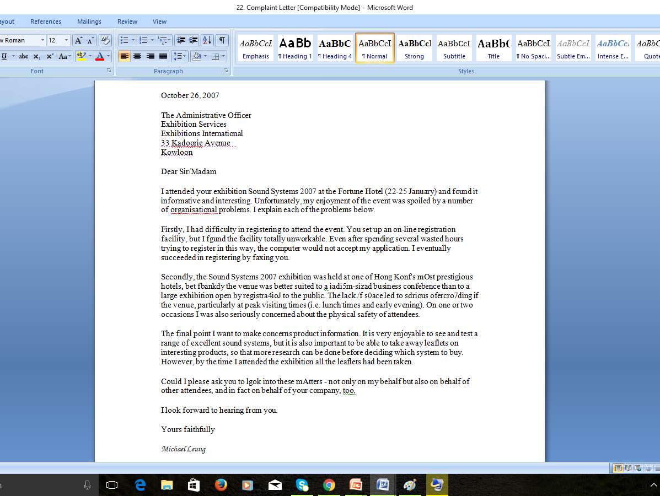
Sample:
Complaint
Letter

Slide 10

Letter Writing
Cover Letter
A supplement to the resume that includes more detailed information about yourself.
Shows off your qualifications to a prospective employer.
Expresses your interest in a position.
Highlights key points in your resume.

Slide 11
Letter Writing
Cover Letter: Prior Preparations
Research regarding the employer and company
Review websites, brochures, pamphlets and any other pertinent materials
Try to speak with current employees for getting the inside perspective
Time to demonstrate yourself better than the rest
Brainstorm to prove why you are the ideal candidate for the job

Slide 12
Letter Writing
Cover Letter: Precautions
You-Attitude: Maintaining focus on the employer instead of using ‘I’
Not more than one page, Not more than three to four paragraphs (to save time of the employers)
Purpose is to highlight your resume’s selling points
No need to mention any weak side of your personality
Stay positive and mention all the good points to impress your employers
Remember to sign your letter as well
Do not go over a page
Maintain friendly and professional tone throughout the letter

Slide 13

Letter Writing
Cover Letter: Writing Steps
First, set the scene and explain why you are writing.
Secondly, provide details and supporting evidence for what makes you better than the other candidates.
Lastly, you make a space to receive an interview call.
Proofread and edit to remove spelling errors and typos.

Slide 14
Letter Writing
Cover Letter: Opening Paragraph
Grabbing the readers’ attention
Discuss the position you are applying for
You can mention the source through which you received the information about the job
Highlight the main points covered in the letter

Slide 15
Letter Writing
Cover Letter: Opening Paragraph Example
Dear Mr. Pierce:
As the enclosed resume attests, the customer support position advertised in the Atlas Group is a perfect fit with my qualifications. My experience working as a Help Desk Student Assistant in the Division of Information Technology at San Francisco State University and my vast experience in the audio field has prepared me for the technological and user support this job requires, making me an ideal candidate for this position.

Slide 16
Letter Writing
Cover Letter: Body Paragraph
Emphasize your top selling points or highest qualification
Show how these qualifications will benefit the company you are applying for
Provide examples of your achievements that have benefited previous companies
Be specific in your description

Slide 17
Letter Writing
Cover Letter: Body Paragraph Example
As my resume highlights, I have offered high-responsibility computer and software support for faculty, staff and students. This experience, along with constant home use of computers, has given me a thorough background of many different forms of software and operating systems including the Windows and Apple families, Microsoft Office, and Dreamweaver. I have also become very comfortable Performing hardware and software upgrades on Windows and Mac machines and working with various types of networks including wireless and LAN. In addition, I master new skills quickly and complete tasks efficiently.

Slide 18
Letter Writing
Cover Letter: Closing Paragraph
Thank the readers for their time spent
Ask for an interview
Set date and time
Create an active ending (you contacting them rather than the organization contacting you for further correspondence)

Slide 19
Letter Writing
Cover Letter: Closing Paragraph Example
Please take the time to look over my resume, and feel free to contact my references. I would love to further discuss this position in person. I will follow up with you in a few days to answer any preliminary questions you might have. In the meantime, please do not hesitate to contact me at 03XX-XXXXXXX (your number).
Thank you for your time and consideration.

Slide 20
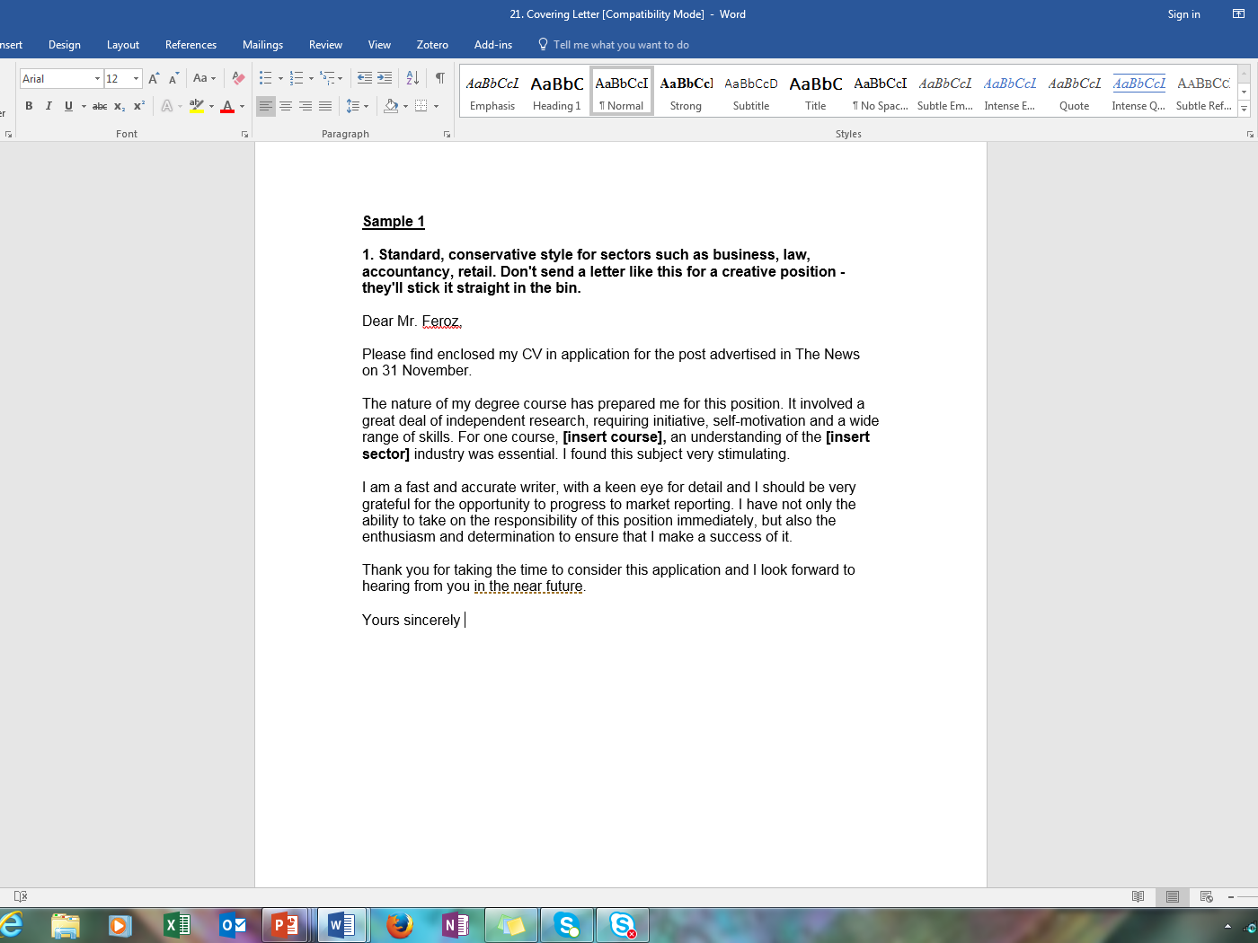

Slide 21
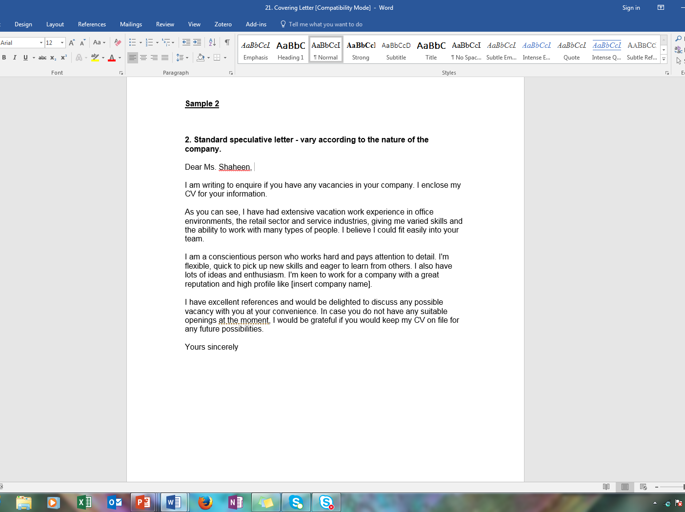

Slide 22
Letter Writing
Good News Letter
Letter which provides a good news/ good message/ favorable information
Appreciation/thanking/felicitations
Positive/encouraging/uplifting/desirable content

Slide 23
Letter Writing
Good News Letter: Steps
Audience analysis
Clarity of subject
Search for all the factual information to be included within the newsletter
Use of comprehensible vocabulary
Editing and proofreading

Slide 24
Letter Writing
Good News Letter: Introduction
Explain purpose and subject matter
As the focus is a good news so begin with a positive tone
Example: Appreciation of a colleague
“You have proved to be indispensable again. Your work for the text book committee has made all of our jobs easier.”
Example: Promoting an employee
“Congratulations! We’re proud to offer you early promotion.”

Slide 25
Letter Writing
Good News Letter: Discussion [1/2]
The next step is to justify the point which you have made in the introduction
Providing relevant details
In the case of appreciation:
“Thank you for performing the following services:
Meeting with all the sales reps to convey our departmental requirement
Reviewing those texts with computer aided design components
Screening the textbook options and selecting the three most suited to our needs”

Slide 26
Letter Writing
Good News Letter: Discussion [2/2]
In the case of promotion:
“You’ve earned a grade raise to PKR XYZ for the following reasons:
Productivity: Your line personnel produced 2,000 units per month throughout this quarter.
Efficiency: You maintained a 95 percent manufacturing efficiency rating.
Supervisory skills: You receive only four grievances and your annual performance appraisals showed that your subordinates appreciated your motivational management techniques .”

Slide 27
Letter Writing
Good News Letter: Conclusion [1/2]
Your last paragraph should state what you plan next
Date and time to execute the future plan
Significance of the shared date and time
In case of appreciation:
“Due to your assistance, we have decided on the text and plan to place our orders this April. That will allow us to stock the bookstore for the fall semester. Your work has made a difference, and we appreciate your efforts another job well done!”

Slide 28
Letter Writing
Good News Letter: Conclusion [2/2]
In case of promotion:
“Because of your excellent work, you will receive you pay increase the first of next month. You deserve it. Good work.”

Slide 29
Letter Writing
Bad News Letter
Letter which provides a bad news/ bad message/ unfavorable information
Rejecting a job applicant
Denying an employee’s raise
Rejection of a proposal
Rejecting a customer’s request for refund
As the main point is a bad news, structure your correspondence to avoid offending your readers

Slide 30
Letter Writing
Bad News Letter: Introduction [1/2]
Be very careful while structuring this section as it should not directly state the bad news which would directly offend the reader.
No need for concisely stating the bad news as it would be harsh and abrupt.
Prepare the reader for the upcoming information.
Start with content which your reader can accept as valid.
In case of rejecting a job applicant:
“Thank you for your recent letter of application. As you can imagine, we received many letters from highly qualified applicants.”

Slide 31
Letter Writing
Bad News Letter: Introduction [2/2]
In case of Terminating a Client/Vendor Relationship:
“As you know, our business demands exact tolerances and precise work man ship. Because of these requirements and the reputation your company has for quality production, we were happy to pursue a long term contract with you.”

Slide 32
Letter Writing
Bad News Letter: Discussion [1/2]
No more delays
Present the inevitable bad news
In case of rejecting a job applicant:
“Although we appreciate your interest in Nayatel, the advertisement specifically required that all applicants have an M.S. in computer science and at least five years of experience in telecommunications. We also suggested that a knowledge of fiber optics would be preferred. Your degree meets our criteria successfully. However, your years of experience fall below our requirements, and your resume does not mention fiber optics expertise. Therefore, we must reject your application.”

Slide 33
Letter Writing
Bad News Letter: Discussion [2/2]
In case of ending the Client/Vendor relations:
“However your last two shipments contained flawed goods. In fact, we found these problems:
37 percent of your shipped components were off tolerance by 0.25 mm.
Your O-rings suffered stress fractures when under 2,000 lb. of pressure.
Because of these failures, we are returning the products.”

Slide 34
Letter Writing
Bad News Letter: Conclusion [1/3]
Do not leave your readers feeling defeated and hopeless
Try to maintain the following relations at the end:
Customer/client
Supervisor/subordinate
Employer/employee
Conclude by giving your readers an opportunity for future success
Provide options which will allow your readers to
Get back in your good graces
Seek employment in future
Reapply for refund
Try to make your readers feel as happy as possible

Slide 35
Letter Writing
Bad News Letter: Conclusion [2/3]
In case of rejecting a job applicant:
“If you have fiber optics knowledge or have acquired additional job experiences which pertain to our work requirements, we would be happy to reconsider your application. In any case, we will keep your letter on file. When new positions open up, your letter will reassessed. Good luck in your job search.”

Slide 36
Letter Writing
Bad News Letter: Conclusion [3/3]
In case of ending a vendor/client relations:
“If you can correct these problems and document to our satisfaction that the errors have eliminated, we would be willing to reconsider our stance. We have enjoyed working with you, John and look forward to the possibility of future contracts.”

Slide 37
Letter Writing
Essential Tips for Letter Writing [1/2]
Be professional and courteous by sending your letter in a timely manner. Do not procrastinate.
When responding to previous correspondence, it is often a good idea to repeat important information. Your response letter is also a wonderful opportunity to ask any questions or clear up any misunderstandings you might have.
When asked for advice, respond quickly. Give advice only on the subject you have been asked about. Keep your advice simple and to the point, and make it easy for the person to respond if he or she wants to discuss the subject at greater length.
If you have been asked for advice and do not feel that you can give it, express your regret, and suggest that someone else would be in a better position to be of assistance.

Slide 38
Letter Writing
Essential Tips for Letter Writing [2/2]
Avoid comments or expressions of personal opinion, unless they are complimentary.
Even if your letter contains negative information (such as declining a job offer, denying someone credit, or declining to follow a suggestion), the tone should still be positive and courteous.
When responding to your reader, a long letter is generally not necessary. Just include enough information to address the issue at hand.
It is often a good idea to thank the reader for his or her time and interest.

Slide 39
Conclusions
Complaint Letter
Cover Letter
Good News Letter
Bad News Letter

